Slide 1
DevOps office Model with CI/CD

Slide 2
INTRODUCTION
Customer needs a vendor who can deliver software solutions faster
Companies use latest and advanced technologies to speed up software development process

Slide 3
Limitations of Existing System
Tools and services for software development are installed manually
Requires constant human intervention during any setup or modification in the system
Addition of new components and tools is not easy
Administration of large number of servers is difficult
Consumes a lot of time and human resources

Slide 4
PROPOSED SYSTEM
Automates the installation of tools and services
Frequent changes to the system can be done easily
Enables the easy and efficient administration of a distributed system since there is minimal manual intervention in the system.
Automates the deployment of code for the services
Monitors the entire system and its services

Slide 5
Goals of project
Installation and setup of DevOps tools
Integration of multiple tools within the DevOps chain
Automation of DevOps tools installation and code deployment
Monitoring of the entire system and its services

Slide 6
Tools Dependencies
Code
Agile Development
Project Management
Engineering
Requirement
Jira
Code Review
GIT
SCM
Git
Build & Analyze (CI)
Build Tools Maven -> Tomcat(Server)
Build Server Jenkins
Build Farm
Build Farm
Build Farm
Deploy & Release
(CD)
Artifactory
Jfrog
Deployment
Puppet
Monitoring
Nagios/Zabbix
Hypervisors (Virtual Machine)

Slide 7
Module wise tools explanation of architecture JIRA
Planning the flow of the project from beginning till the end and tracking it i.e. project management
Issues aroused - Jira lets priorities, assign, track, report and audit the ‘issues’ whatever may be from software bugs and help-desk tickets to project tasks and change requests and are Customizable for reporting and statistics which can be monitored .
We have used Database i.e. MySQL
Has advanced searching Jira Query Language

Slide 8
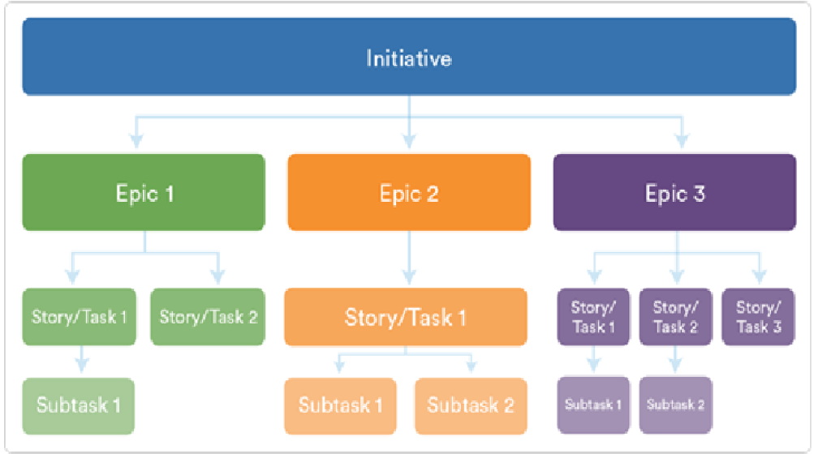
Structure of JIRA
Epic Large body of work, contains stories | Story Smallest unit of work, also known as a task | Tasks A unit of work contained within a story | Subtask used to split up a parent task into a number of tasks which can be assigned and tracked separately.
Example
Epic : CI/CD | Story: Linux GIT Maven | Tasks : GIT Installation Maven Installation | Subtask: GIT Installation monitoring GIT Installation Documentation

Slide 9
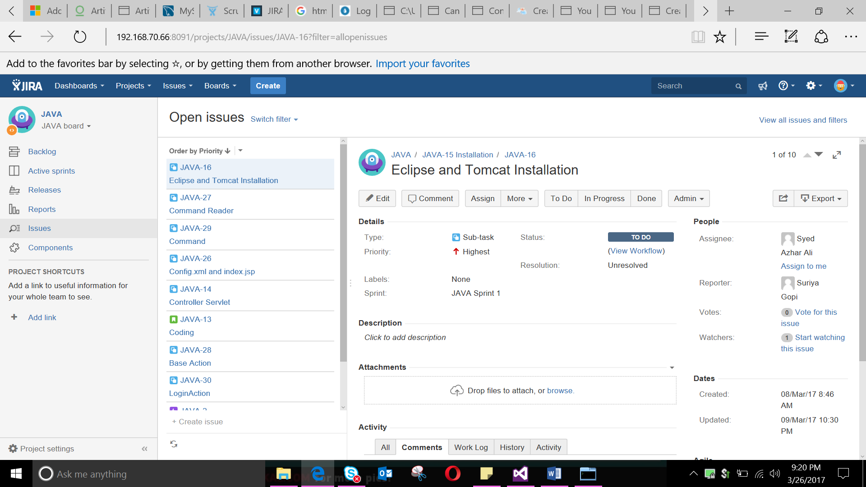

Slide 10
Module wise tools explanation of architecture GIT
It is a Source Code Manager which holds the code that needs to be built
Free and open source
With certain operations like push, pull,commit,add,merge,etc
Each revision is given a time-stamp and includes the name of the person who is responsible for the change.

Slide 11
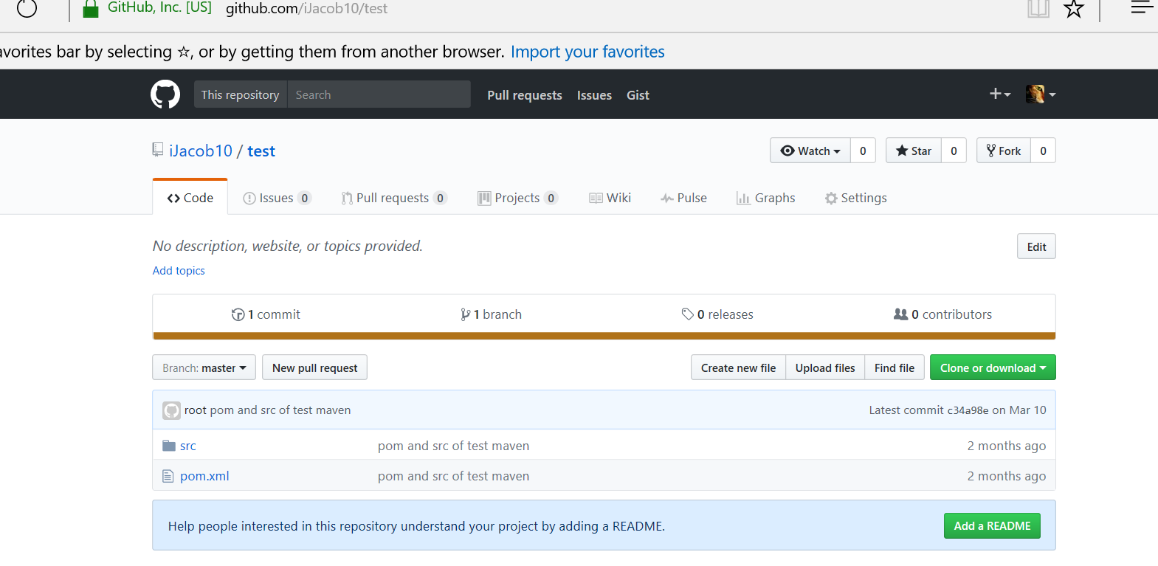

Slide 12
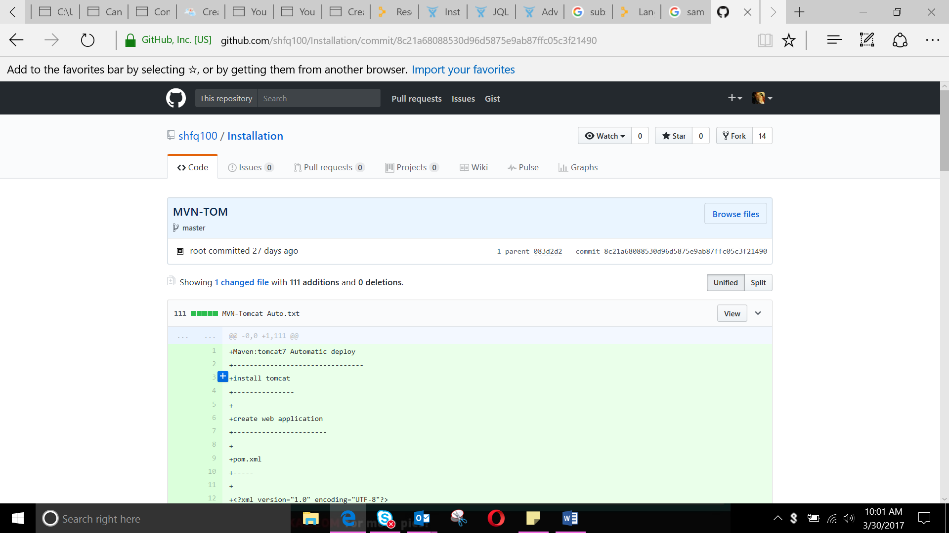

Slide 13
Module wise tools explanation of architecture MAVEN
Build Server : The build tool Maven builds the code and the packages are bundled in this server
Developers can build using IDE such as Eclipse, Intellij etc
Tomcat : Server on which the package is deployed

Slide 14
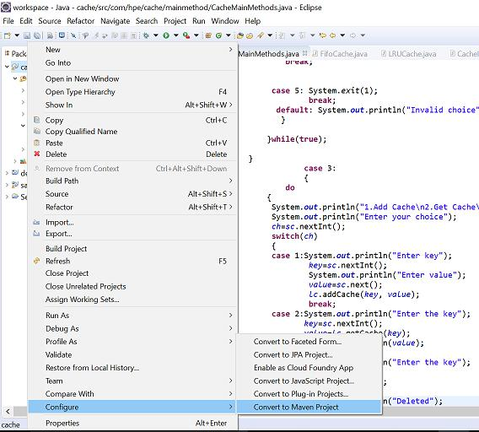
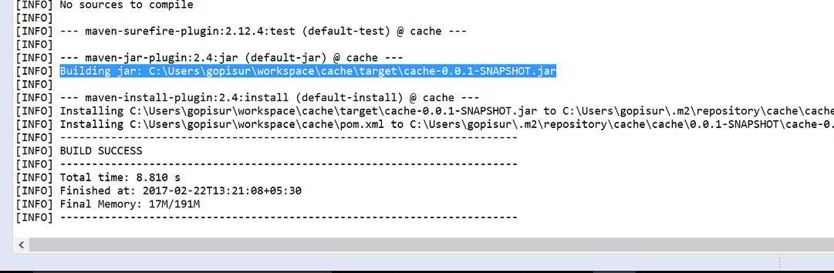

Slide 15
Module wise tools explanation of architecture JENKINS
Build Farm : The build farm tool i.e. Jenkins acts as the Continuous Integration tool which is a development practice that requires developers to integrate code into a shared repository at regular intervals
Jenkins displays build status in an interactive manner
Tomcat : Server on which the package is deployed
We can schedule the build similar to crontab

Slide 16
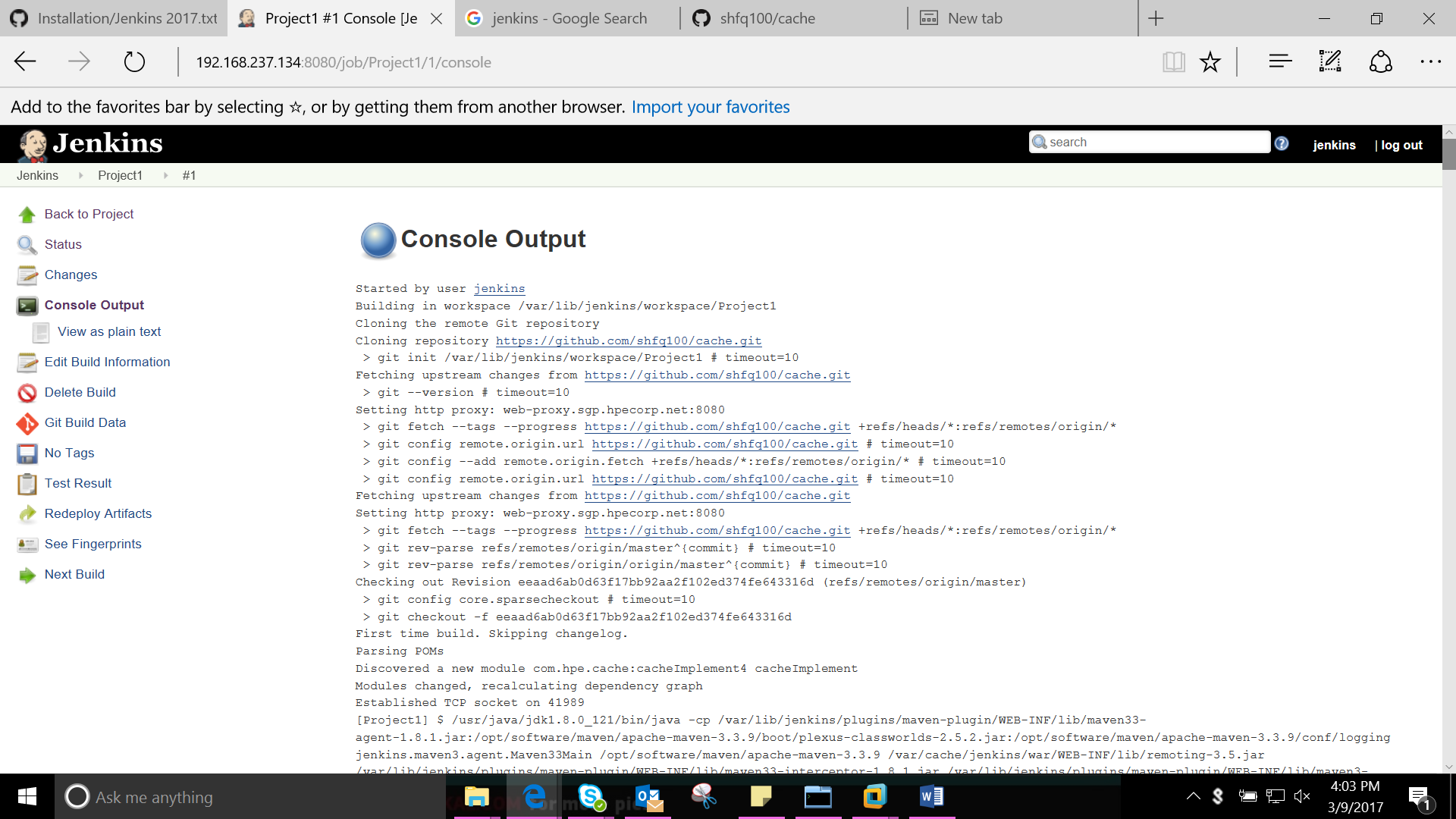

Slide 17
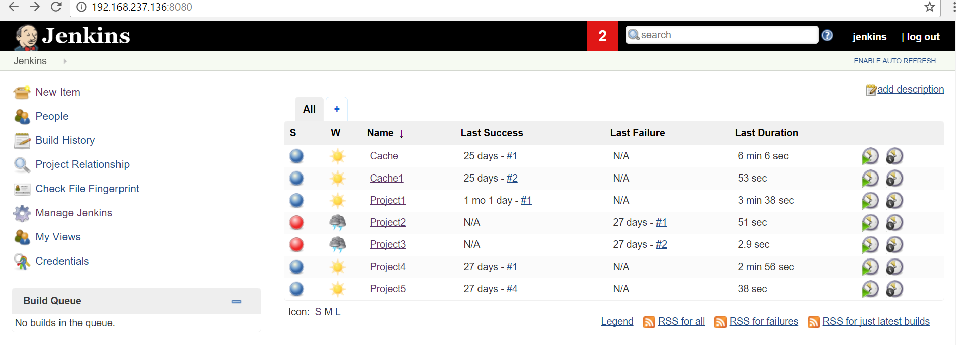
Displays status - Jenkins

Slide 18
Module wise tools explanation of architecture JFROG
Increase Build Speed and Proxy Remote Artifacts. Eliminate redundant downloads by automatically caching artifacts for the entire development team.
It contains the built packages in the form of .war or .jar
Share Artifacts Across Teams. Easily distribute Artifacts produced by different teams in your organization, and share them as dependencies between the teams as needed.
Creates a Maven repository where all Artifacts like dependencies, plugins and packages are stored. Once it is integrated with Jenkins, Jenkins will take all dependency plugins from this artifactory to build the package()

Slide 19
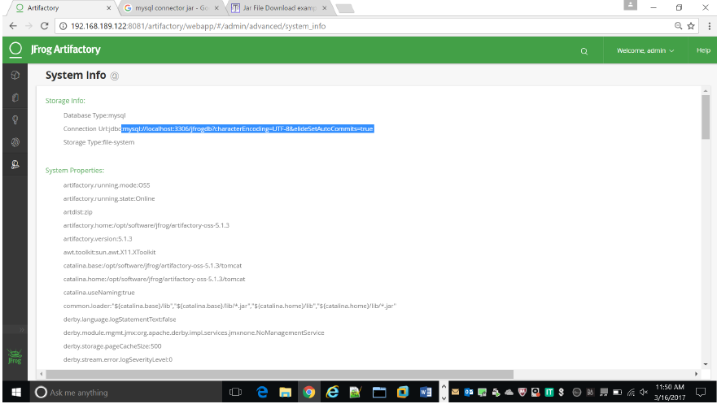

Slide 20
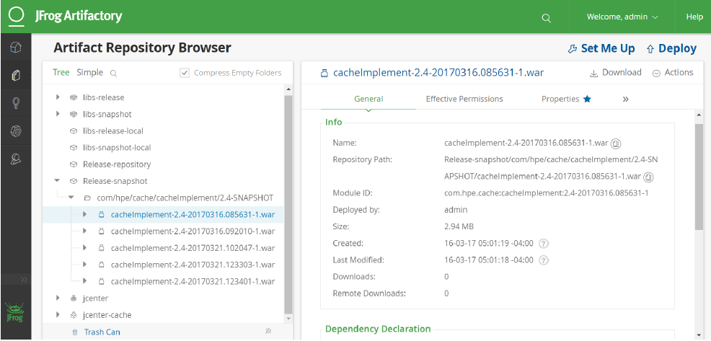

Slide 21
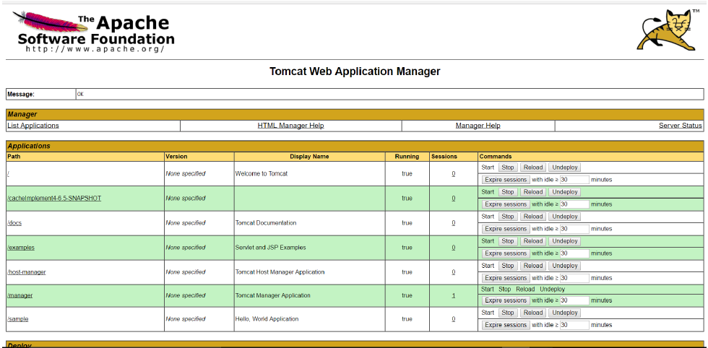

Slide 22
Module wise tools explanation of architecture PUPPET
Puppet automates the code deployment and installation of services and tools . It automates the DevOps tools using scripts
This helps to achieve the Main goal of the project i.e.
Automates the installation of the DevOps tools and services ,through customized puppet scripts
Integration of multiple tools within the DevOps chain
Enables the easy and efficient administration of a distributed system since there is minimal manual intervention in the system.
Automates the deployment of code

Slide 23
PUPPET AUTOMATION
Puppet is an automation tool
It can be used to automate any service
Custom scripts are written in modules folder which contains all scripts

Slide 24
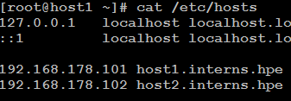
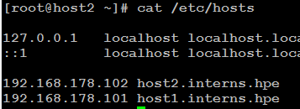
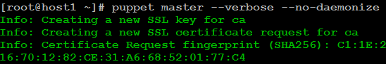
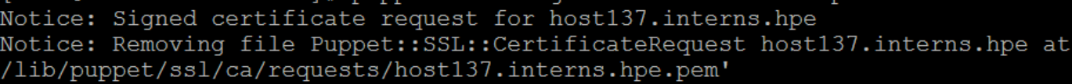
Puppet - Installation
Puppet Master
Puppet Slave
resolve the hostname each other
rpm -ivh http://yum.puppetlabs.com/puppetlabs-release-el-7.noarch.rpm
yum install puppet-server -y
vi /etc/puppet/puppet.conf
[main]
dns_alt_names = host1,host1.interns.hpe certname = host1.interns.hpe
puppet master --verbose --no-daemonize
Start puppetmaster service
puppet cert list
resolve the hostname each other
rpm -ivh http://yum.puppetlabs.com/puppetlabs-release-el-7.noarch.rpm
yum install puppet –y
vi /etc/puppet/puppet.conf
[agent]
server = host1,host1.interns.hpe
puppet agent -t

Slide 25
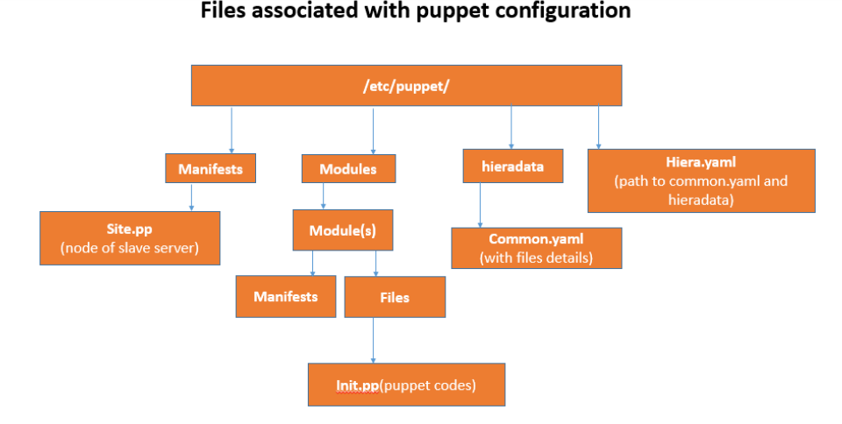
Files associated with puppet configuration
/etc/puppet
Manifests
Modules
Manifests
Files
Site.pp
(node of slave server)
Init.pp(puppet codes)

Slide 26
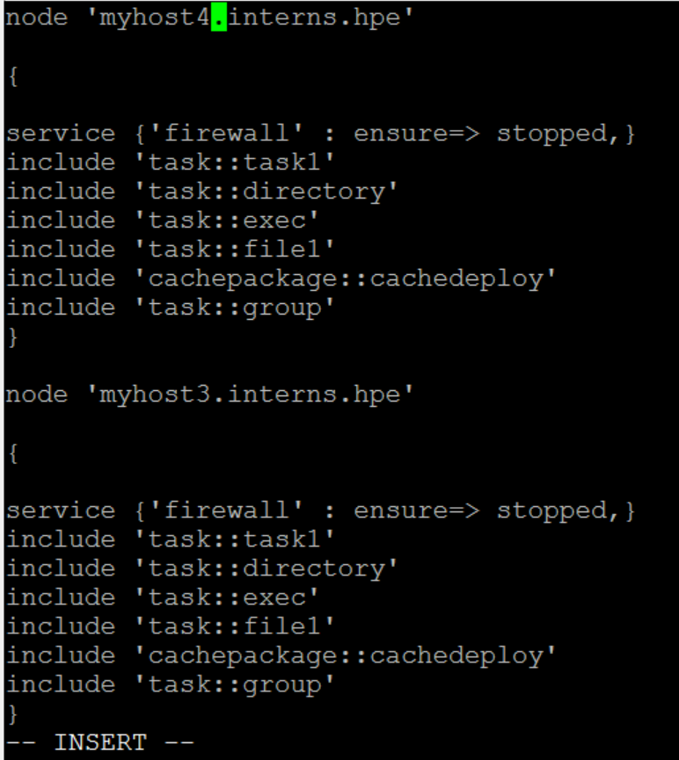
Site.pp file of puppet master where all modules are called and executed

Slide 27
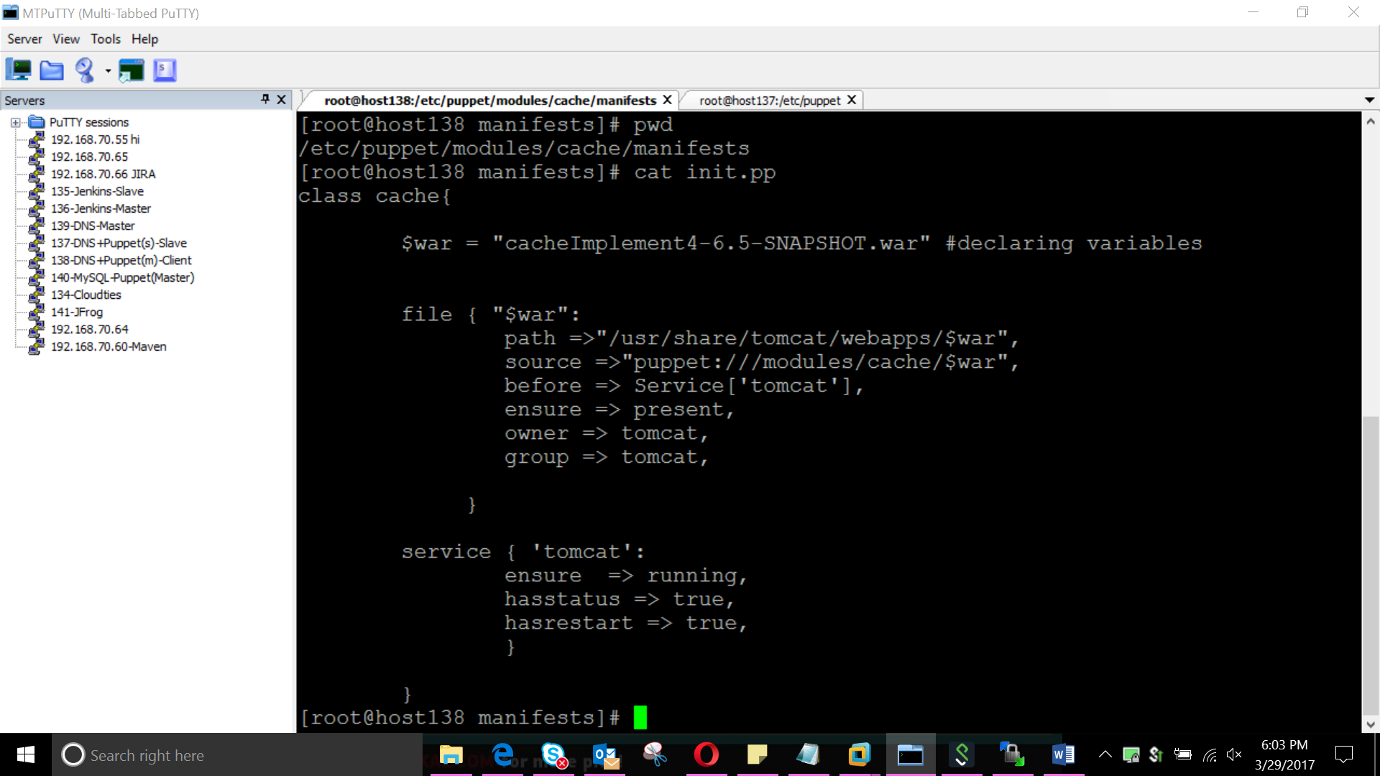
Script for automation of code deployment

Slide 28
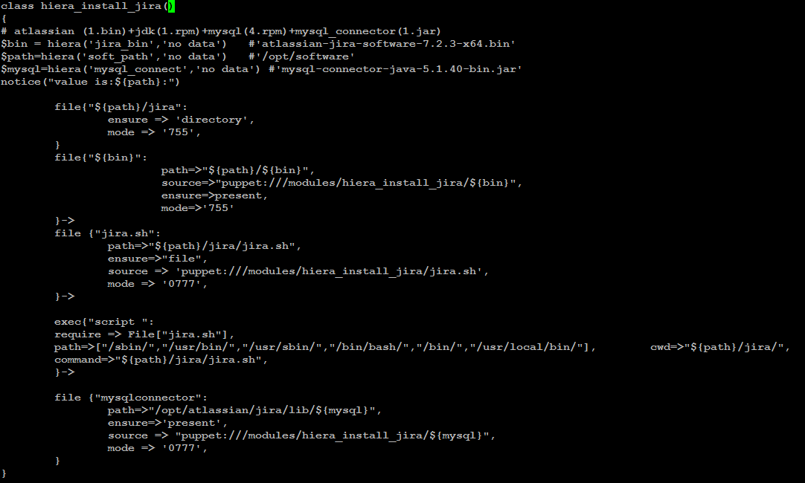
Automation script for JIRA installation

Slide 29
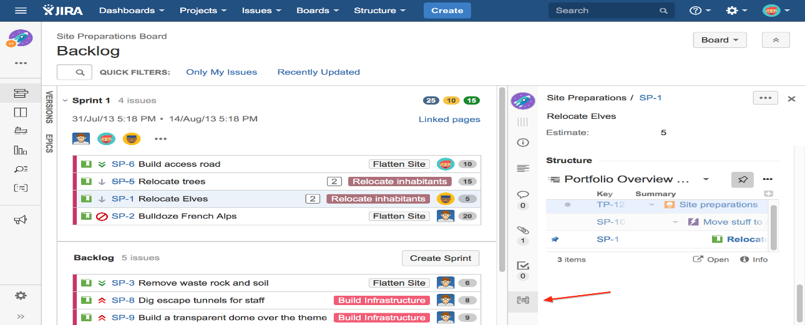

Slide 30
Module wise tools explanation of architecture NAGIOS
Nagios tool that monitors all hosts components and services in the network
Monitoring Terminal : Output console that displays the status of all components in network
To identify the problems and send an alert message to the administrator
(e.g. network administrator)

Slide 31
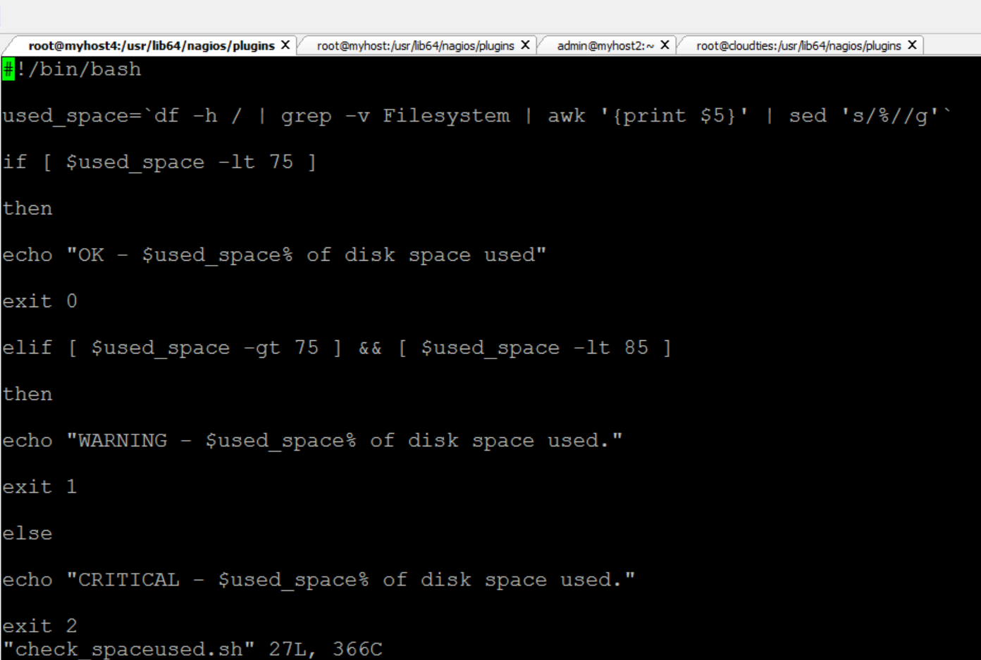
Script to calculate used space in host memory and check status of host

Slide 32
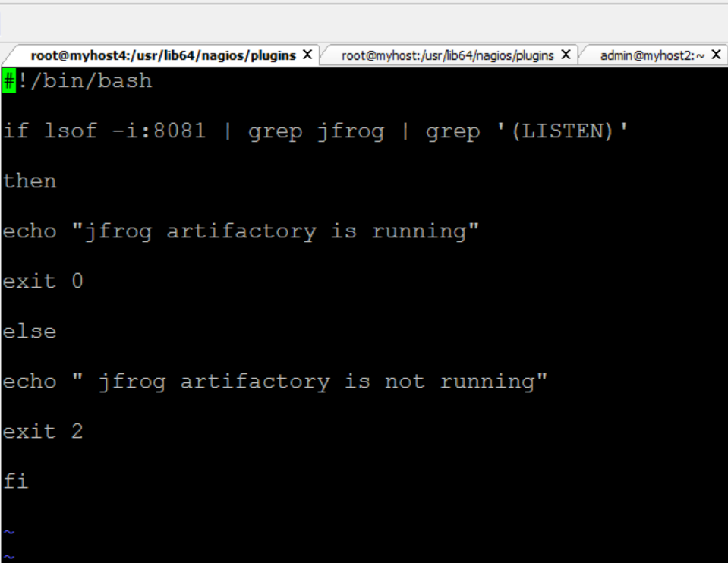
Script to monitor status of Jfrog artifactory and checks whether service is up or down

Slide 33
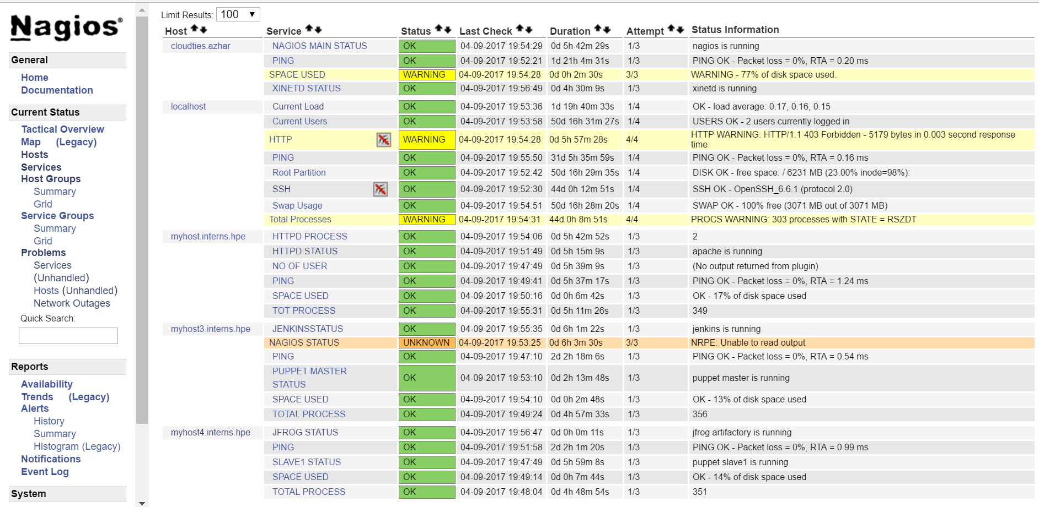
Console view of the list of services and their states

Slide 34
Module wise tools explanation of architecture VMWORKSTATION-HYPERVISOR
Hypervisor : Hypervisor for provisioning new virtual machines
Virtualization is the creation of a virtual -- rather than actual -- version of something, such as an operating system, a server, a storage device or network resources.
We work and store all the data's within the servers with the help of Hypervisors i.e. VMWare Workstation
We can do cloning ,snapshots ,etc with the help of ISO image's(An ISO image is an archive file of an optical disk, a type of disk image composed of the data contents from every written sector on an optical disk, including the optical disc file system)
We used MTPutty a Connectivity Tools which is the most popular SSH client for Windows

Slide 35
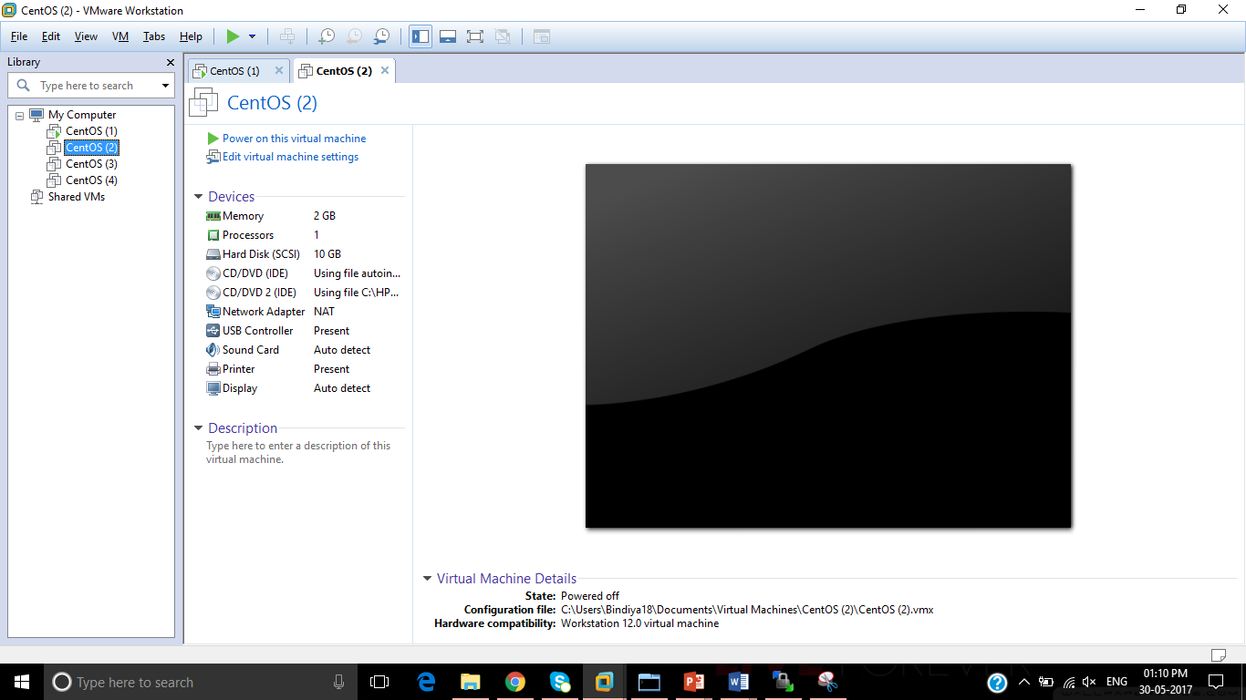

Slide 36
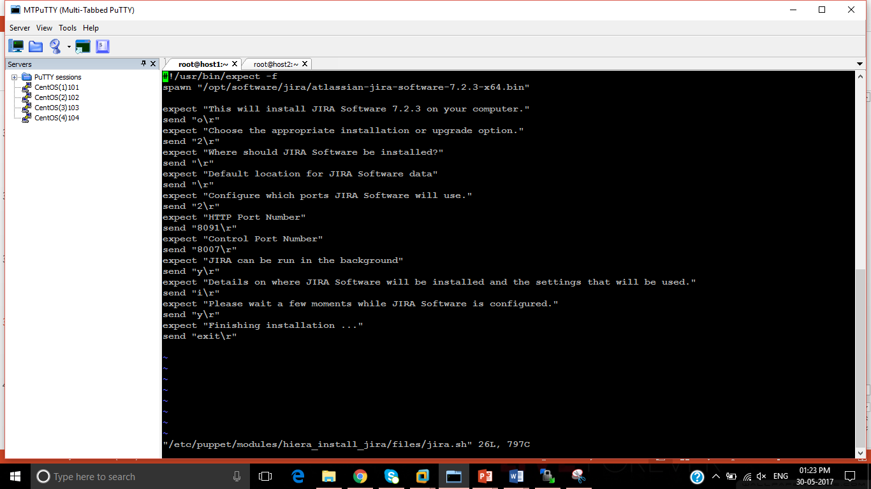

Slide 37
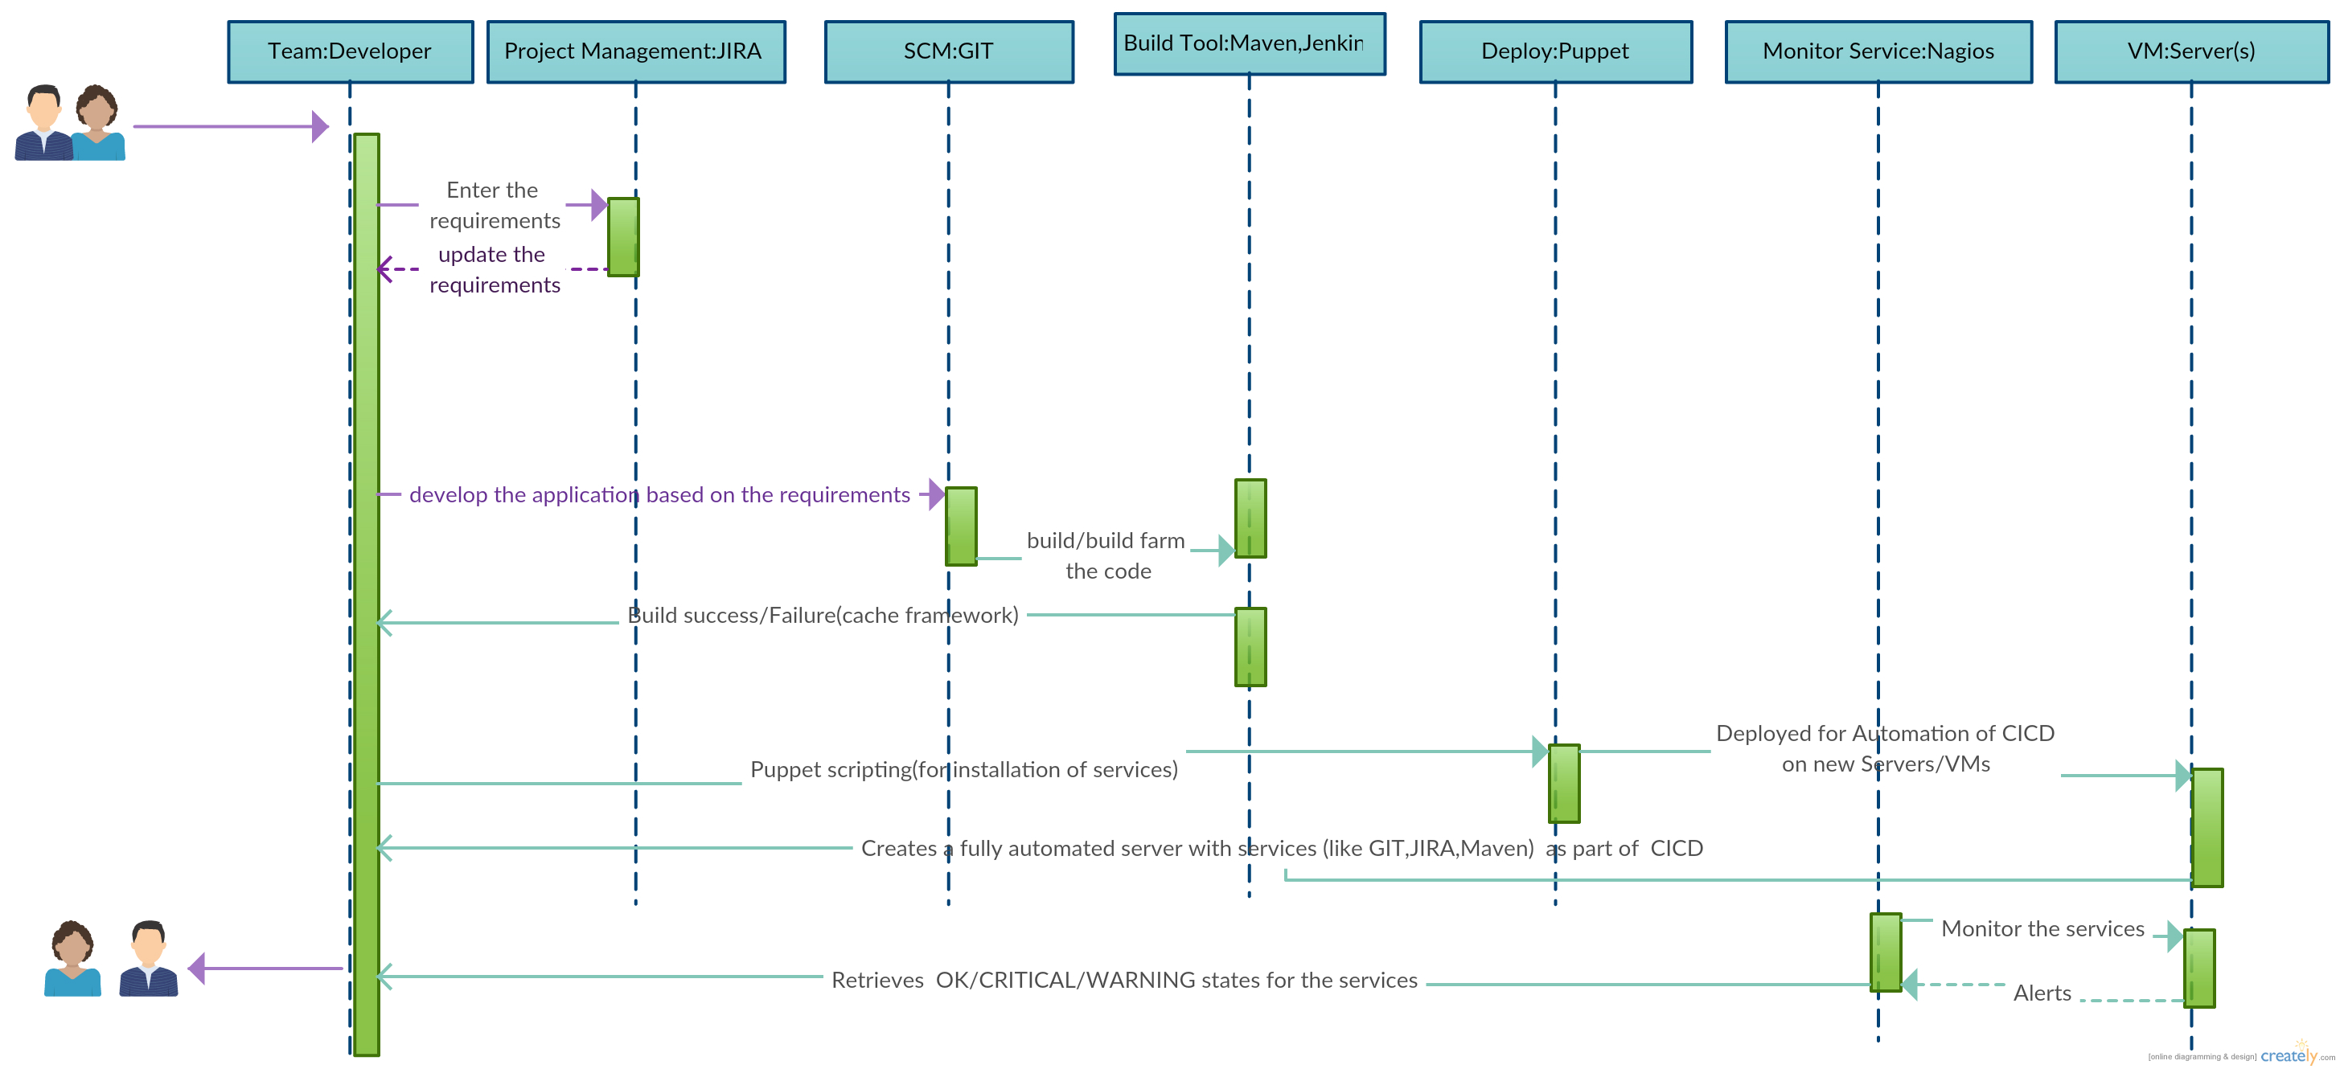
Summary: Sequence Diagram
Goal :Integration of multiple tools within the DevOps chain

Slide 38
Thank You

